Slide 1

Computer Networks
UDP & TCP
S.V.Jansi Rani
Associate Professor / CSE

Slide 2
AGENDA
User Datagram Protocol UDP
Transmission Control Protocol TCP
Segment Format
FSM of TCP
Flow Control
Congestion Control – Tahoe, Reno
Retransmission Timer Management

Slide 3



Slide 4
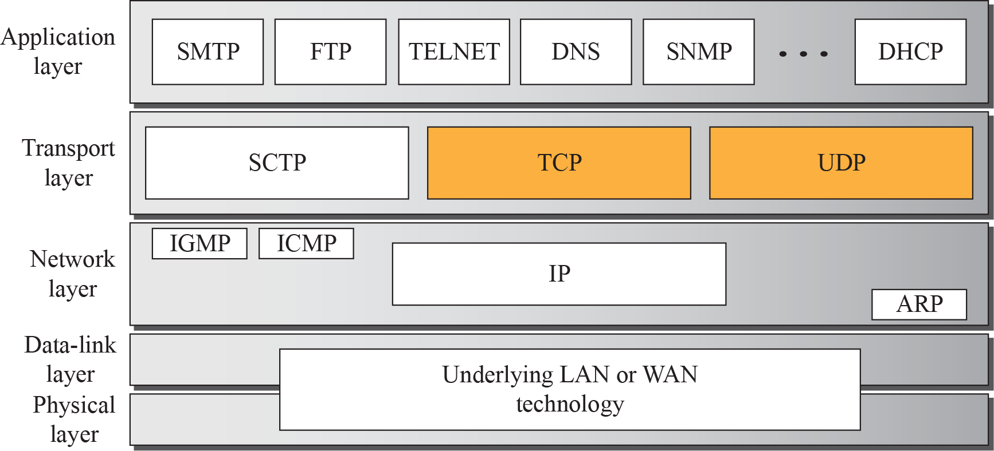
Position of transport-layer protocols in the TCP/IP protocol suite

Slide 5
Port Numbers
Process-to-process communication - use port numbers
Port numbers provide end-to-end addresses at the transport layer and allow multiplexing and demultiplexing at this layer, just as IP addresses do at the network layer.

Slide 6
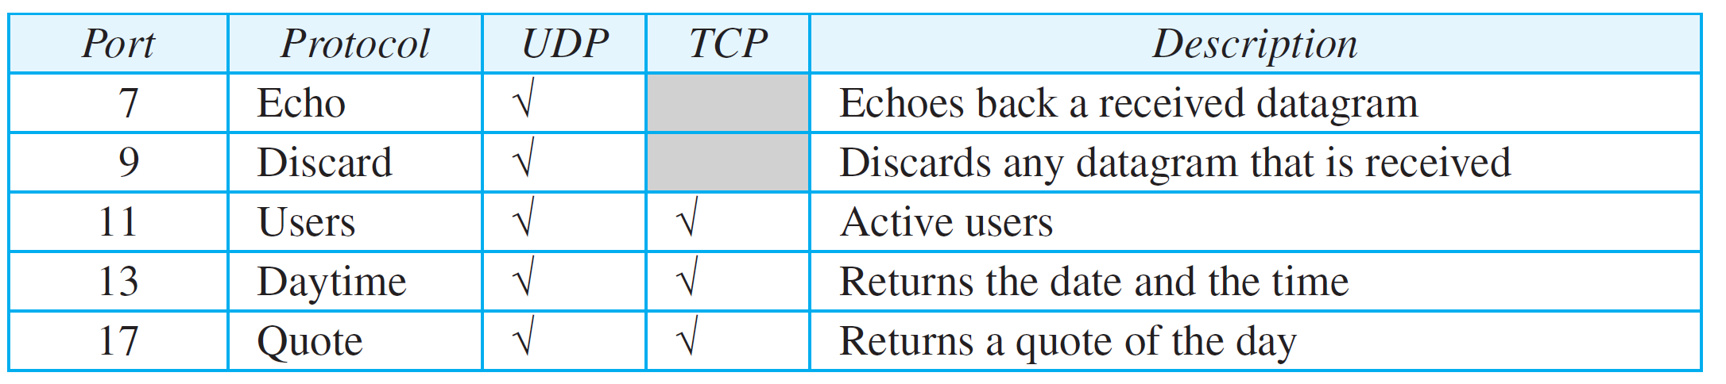
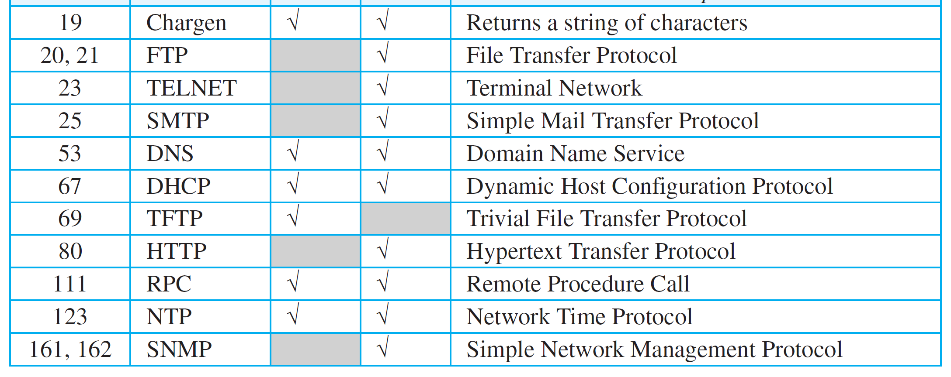
Some well-known ports used with UDP and TCP

Slide 7
UDP
The User Datagram Protocol (UDP) is a connectionless, unreliable transport protocol.
UDP is a very simple protocol using a minimum of overhead.

Slide 8
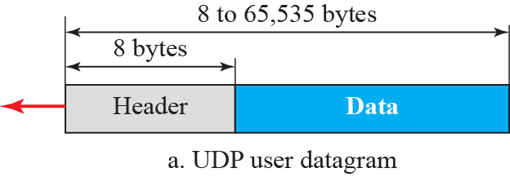
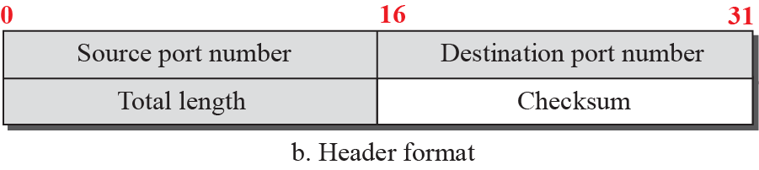
User datagram packet format

Slide 9
UDP Applications
Application which needs simple request response communication
Process with internal flow and error control eg:TFTP
Multicasting
SNMP
Routing table updates eg RIP
DNS

Slide 10
TCP
Transmission Control Protocol (TCP) is connection-oriented, reliable protocol.
TCP explicitly defines connection establishment, data transfer, and connection teardown phases to provide a connection-oriented service.
TCP uses a combination of GBN and SR protocols to provide reliability.

Slide 11
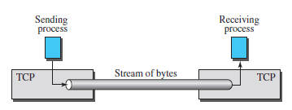
TCP
Process to process communication
Stream delivery service –stream of bytes

Slide 12
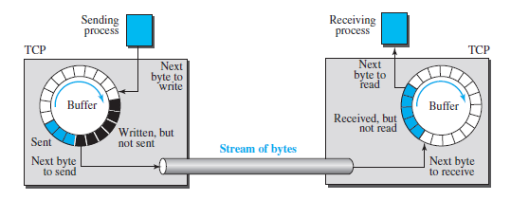
TCP
Process to process communication
Stream delivery service –stream of bytes
Sending and receiving buffers

Slide 13
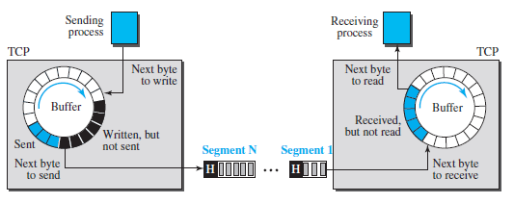
TCP
Segments – full duplex service
Multiplexing and demultiplexing

Slide 14
TCP Features
Numbering System
Byte number – random number for first byte
Between 0 to 2³² -1
Eg: 1057 data is 6000 bytes then bytes are numbered from 1057 to
7056
Sequence number
Acknowledgement number – number of next byte a party expects to
receive

Slide 15
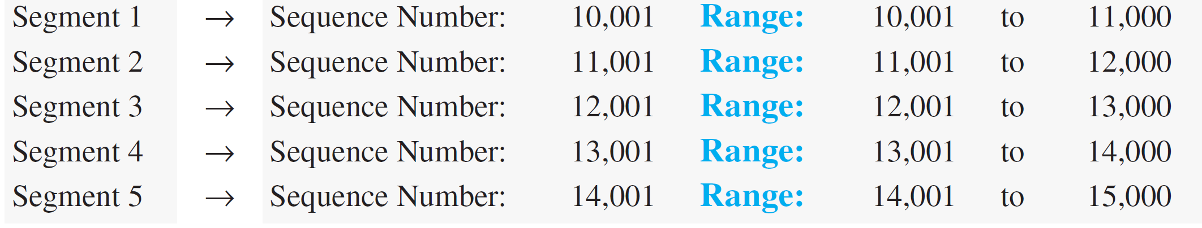
Example
Suppose a TCP connection is transferring a file of 5,000 bytes. The first byte is numbered 10,001. What are the sequence numbers for each segment if data are sent in five segments, each carrying 1,000 bytes?
Solution
The following shows the sequence number for each segment:

Slide 16
Segment
A packet in TCP is called a segment.

Slide 17
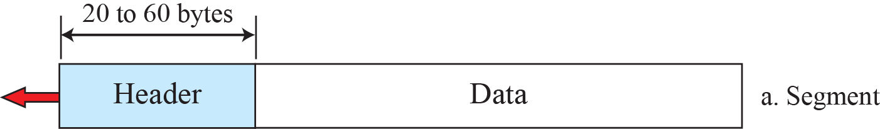
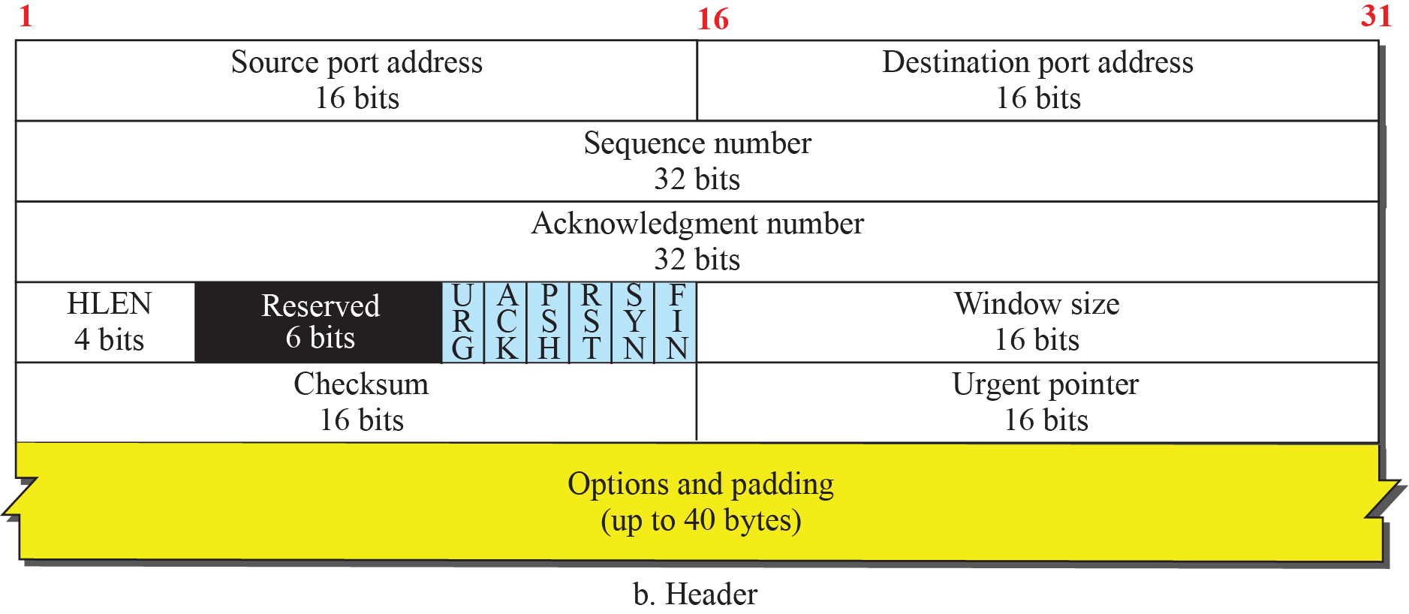
TCP segment format

Slide 18
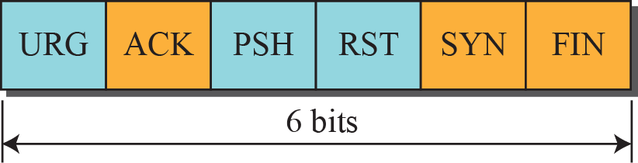
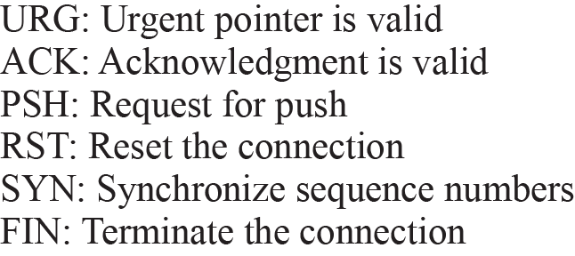
Control field

Slide 19
Example
The following is a dump of a TCP header in hexadecimal format
05320017 00000001 00000000 500207FF 00000000
What is the source port number?
What is the destination port number?
What is sequence number?
What is the acknowledgment number?
What is the length of the header?
What is the type of the segment?
What is the window size?

Slide 20
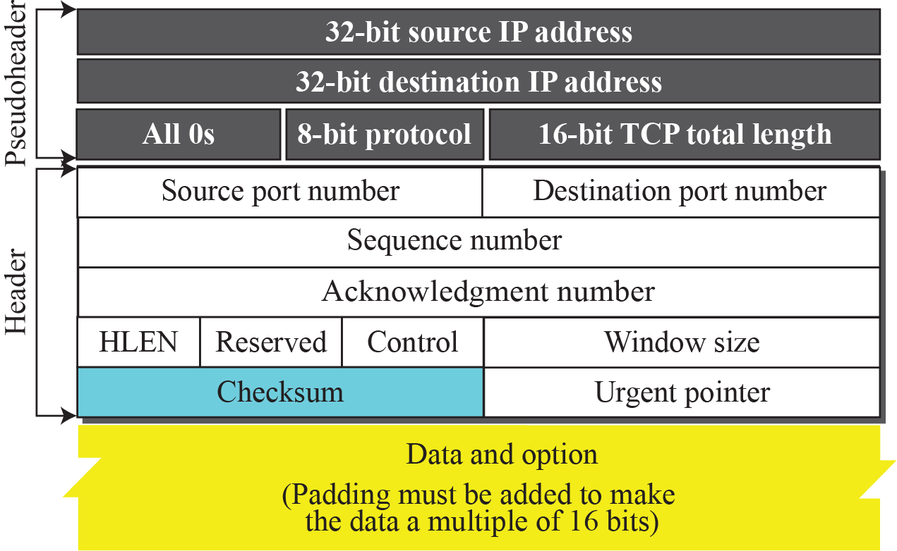
Pseudoheader added to the TCP datagram
Protocol field -UDP: 17, TCP-6
Checksum – pseudoheader, header, data

Slide 21
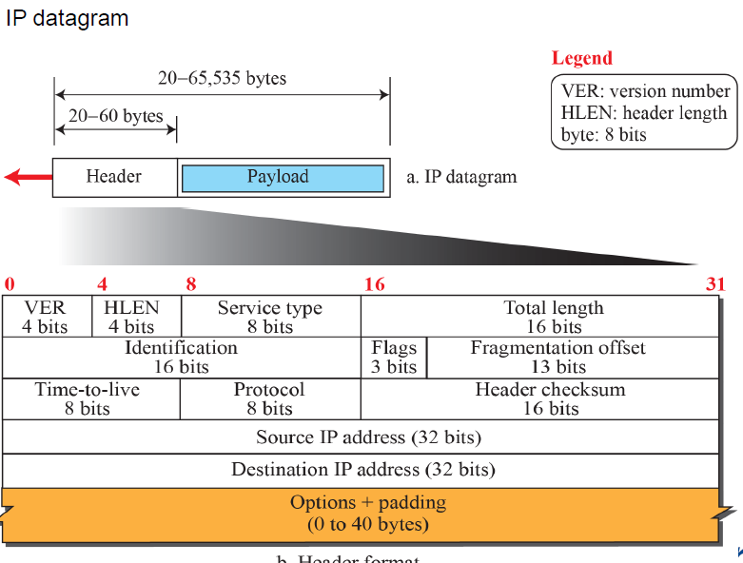

Slide 22
A TCP Connection
TCP is connection-oriented.
You may wonder how TCP, which uses the services of IP, a connectionless protocol, can be connection-oriented.
The point is that a TCP connection is logical, not physical. TCP operates at a higher level. TCP uses the services of IP to deliver individual segments to the receiver, but it controls the connection itself.

Slide 23
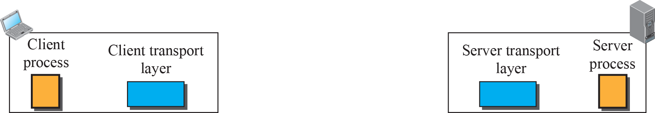
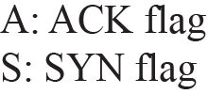
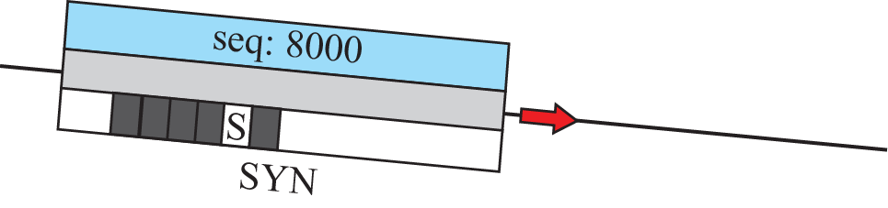

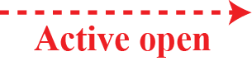
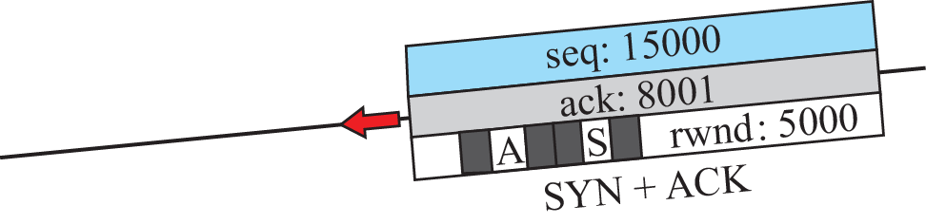
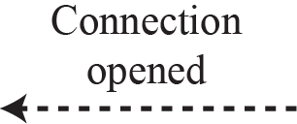
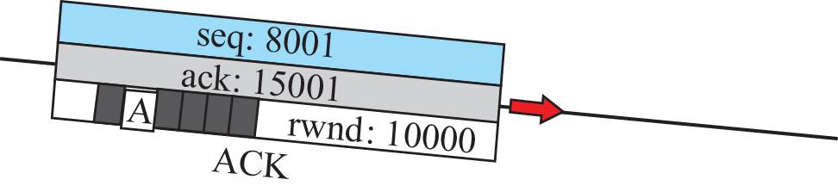
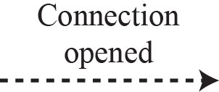
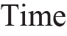
Connection establishment using three-way handshaking

Slide 24
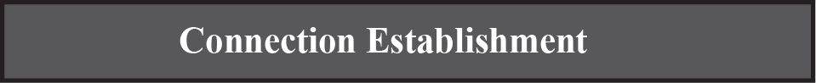
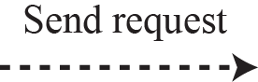
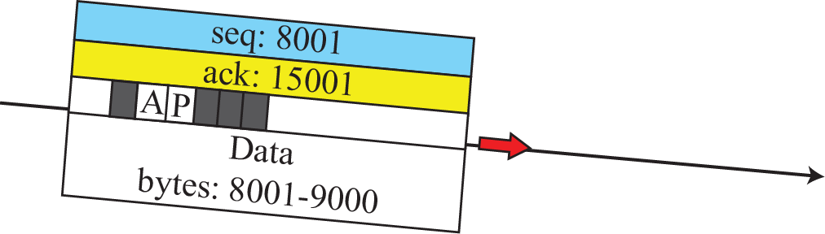
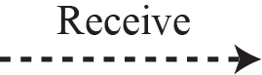
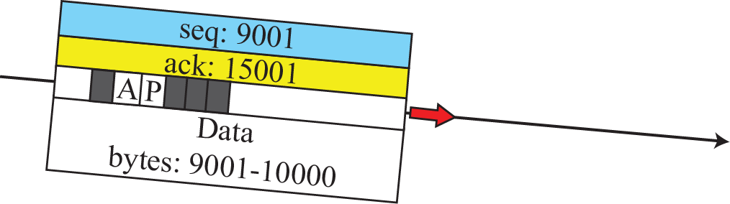
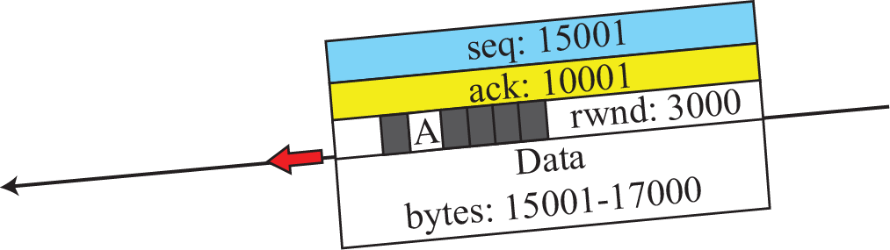
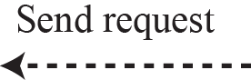
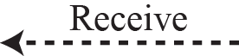
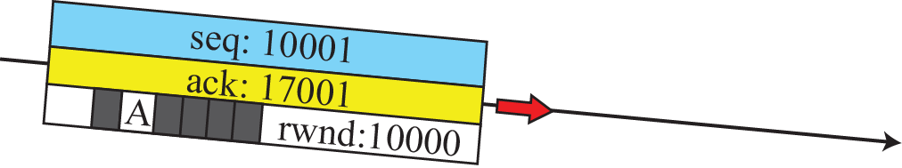
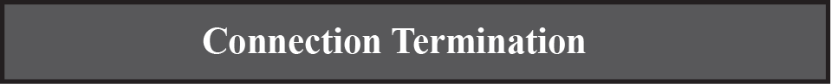
Data transfer

Slide 25
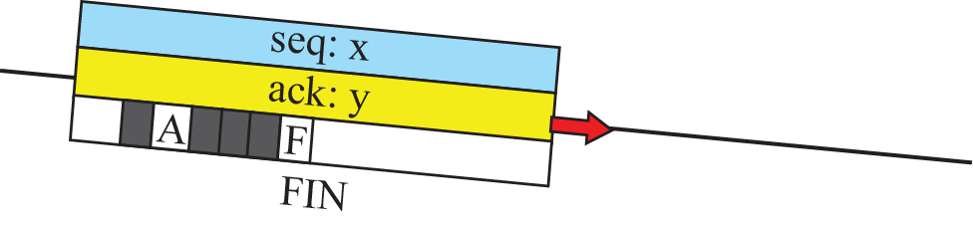
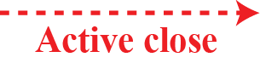
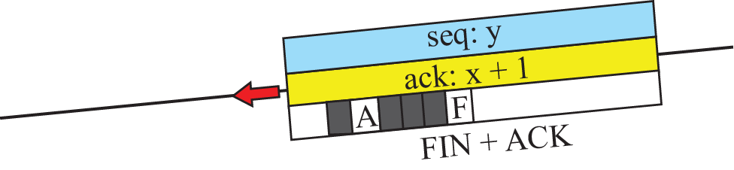
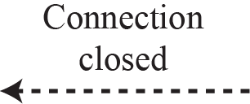

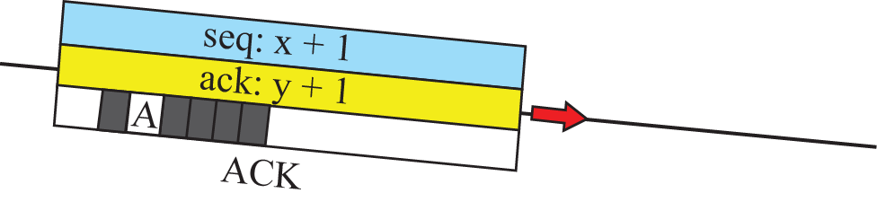
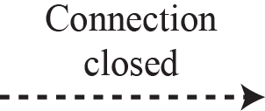
Connection termination using three-way handshaking

Slide 26
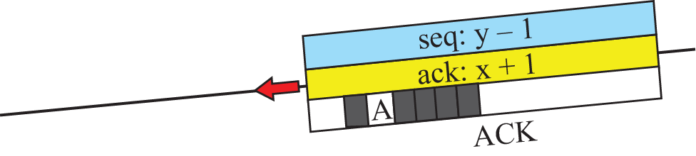
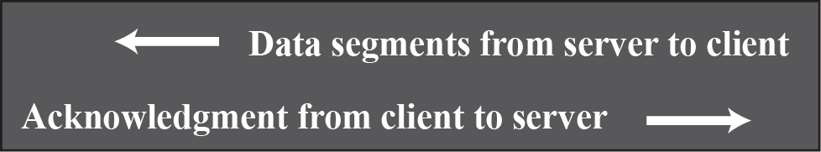
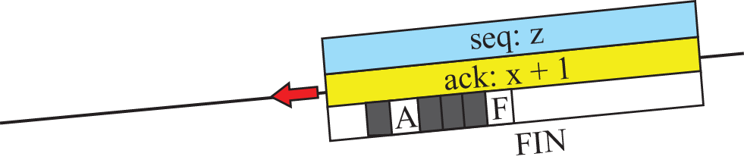
Half-close

Slide 27
State Transition Diagram
To keep track of all the different events happening during connection establishment, connection termination, and data transfer, TCP is specified as the finite state machine (FSM)

Slide 28
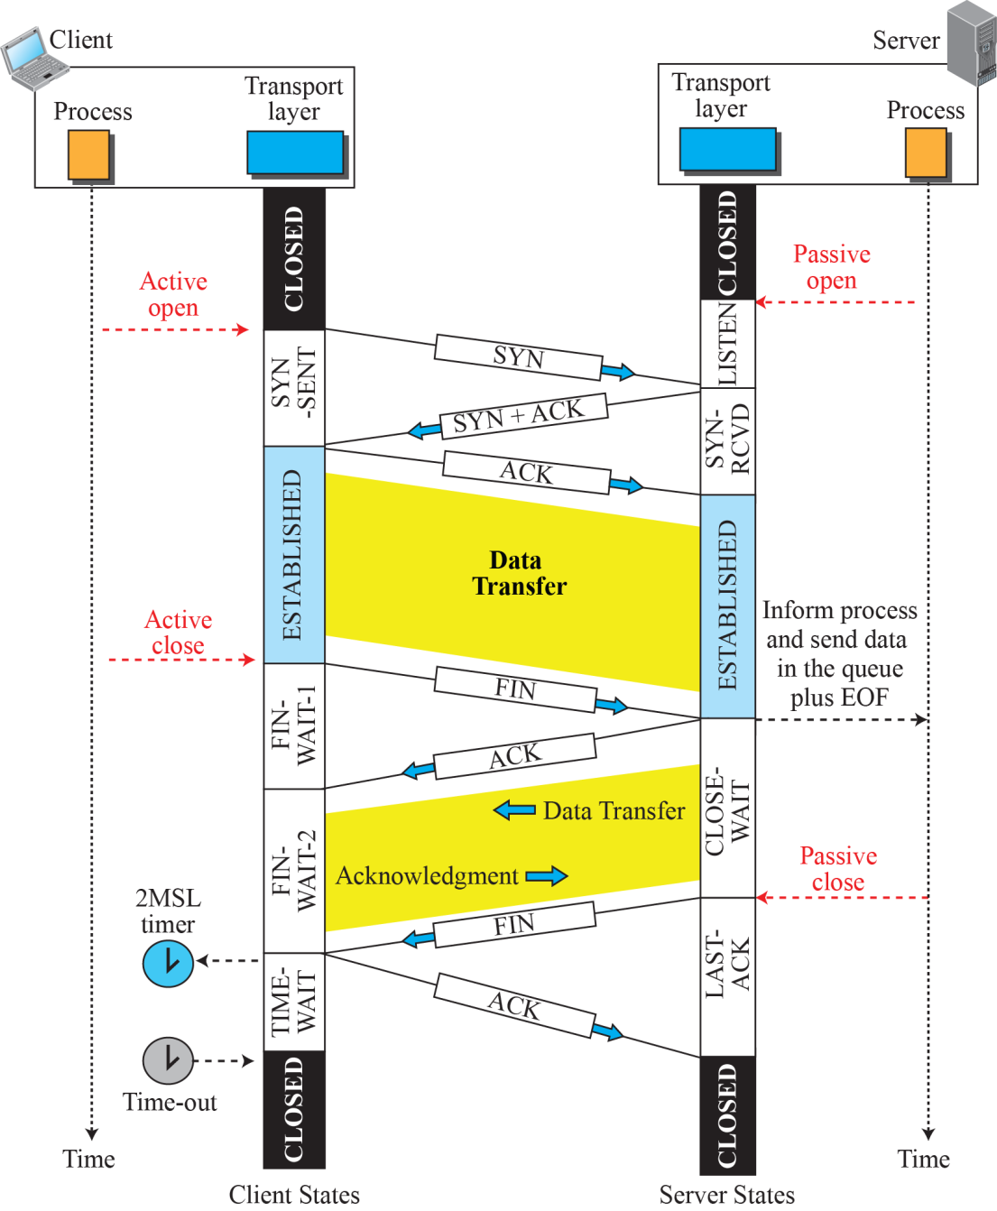
Time-line diagram for a common scenario

Slide 29
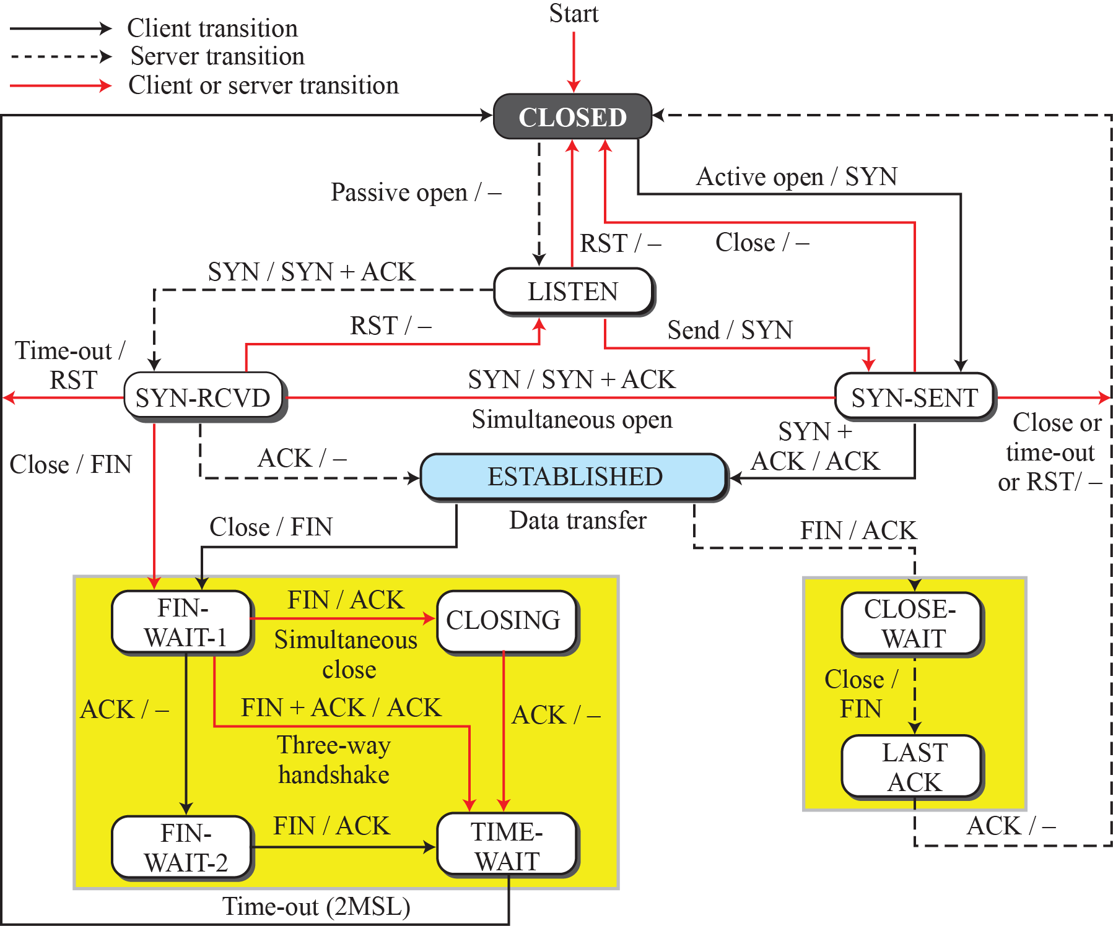
State transition diagram

Slide 30
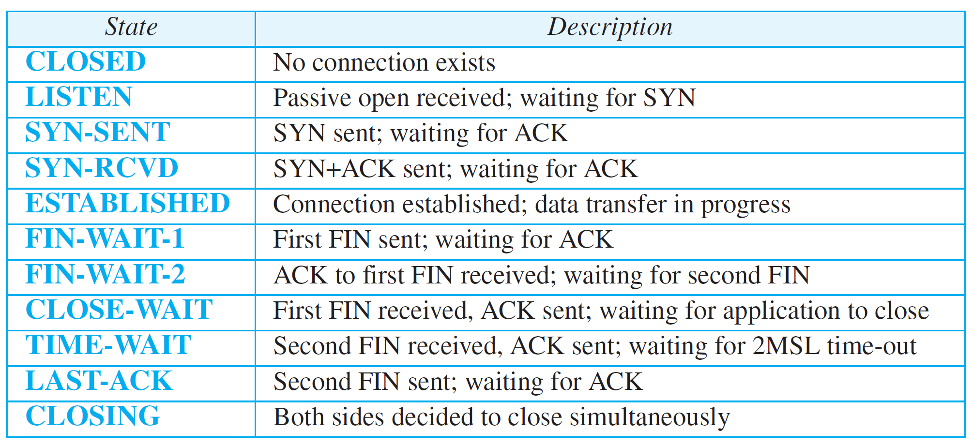
States for TCP

Slide 31
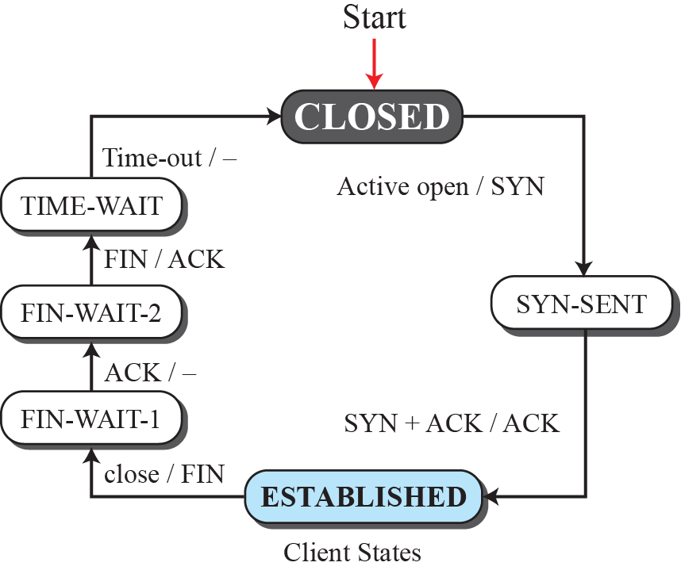
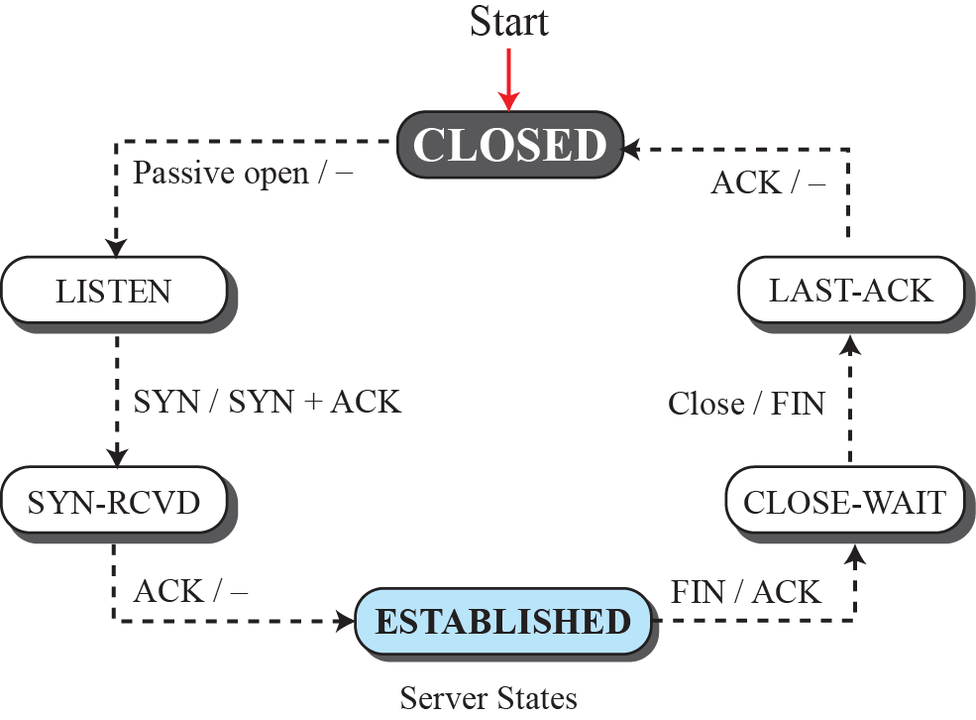
Transition diagram with half-close connection termination

Slide 32
Windows in TCP
TCP uses two windows
Send window
Receive window
for each direction of data transfer, which means four windows for a bidirectional communication
TCP uses only one timer unlike SR.
Assumption that communication is only unidirectional.

Slide 33
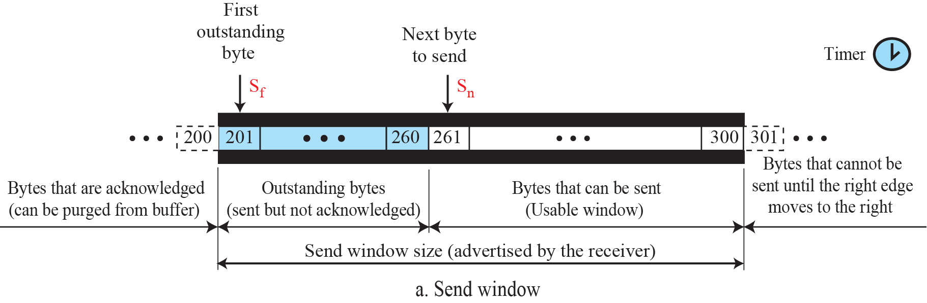
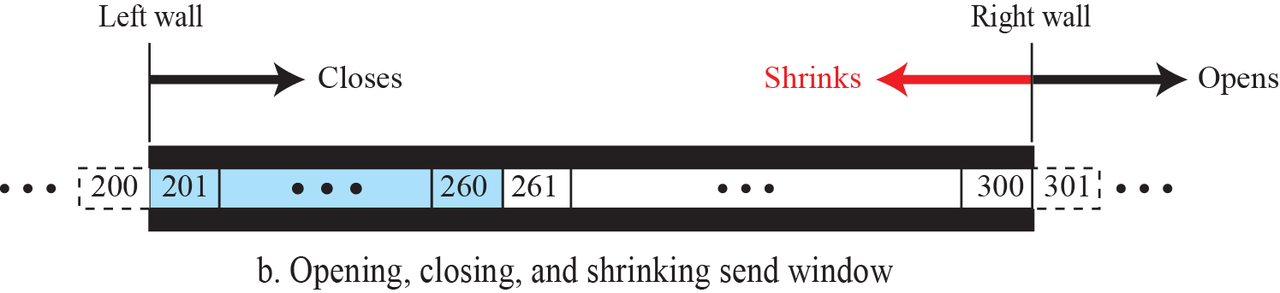
Send window in TCP

Slide 34


Receive window in TCP

Slide 35
Example
What is the value of the receiver window (rwnd) for host A if the receiver, host B, has a buffer size of 5000 bytes and 1000 bytes of received and unprocessed data?
Solution
The value of rwnd = 5000 − 1000 = 4000. Host B can receive only 4000 bytes of data before overflowing its buffer. Host B advertises this value in its next segment to A.

Slide 36
Example
A TCP connection is using a window size of 10,000 bytes, and the previous acknowledgement number was 22,001. It receives a segment with acknowledgment number 24,001 and window size advertisement of 12,000. Draw a diagram to show the situation of the window before and after.

Slide 37
Example
A window holds bytes 2001 and 5000. The next byte to be sent is 3001. Draw a figure to show the situation of the window after the following two events:
An ACK segment with the acknowledgement number 25, 000 and window size advertisement 4,000 is received.
A segment carrying 1000 bytes is sent.

Slide 38







Data flow and flow control feedbacks in TCP

Slide 39

An example of flow control

Slide 40
Silly Window Syndrome
A serious problem can arise in the sliding window operation when either the sending
application program creates data slowly or the receiving application program consumes
data slowly, or both
Solution:
Sender – Nagle’s Algo –
Receiver - Clark’s Solution -till half buffer is empty /
Delayed Ack

Slide 41
Error Control
TCP is a reliable transport-layer protocol. This means that an application program that delivers a stream of data to TCP relies on TCP to deliver the entire stream to the application program on the other end in order, without error, and without any part lost or duplicated.

Slide 42

Simplified FSM for the TCP sender side

Slide 43

Simplified FSM for the TCP receiver side

Slide 44
Error Control
Generating ACK
1. When end A sends a data segment to end B, it must include (piggyback) an acknowledgment that gives the next sequence number it expects to receive - reduces traffic.
2. When the receiver has no data to send and it receives an in-order segment (with expected sequence number) and the previous segment has already been acknowledged, the receiver delays sending an ACK segment until another segment arrives or until a period of time (normally 500 ms) has passed
3. When a segment arrives with a sequence number that is expected by the receiver, and the previous in-order segment has not been acknowledged, the receiver immediately sends an ACK segment. In other words, there should not be more than two in-order unacknowledged segments at any time -prevents the unnecessary
retransmission

Slide 45
Error Control
Generating ACK
4. When a segment arrives with an out-of-order sequence number that is higher than expected, the receiver immediately sends an ACK segment announcing the sequence number of the next expected segment. This leads to the fast retransmission of missing segments
5. When a missing segment arrives, the receiver sends an ACK segment to announce the next sequence number expected. This informs the receiver that segments reported missing have been received.
6. If a duplicate segment arrives, the receiver discards the segment, but immediately sends an acknowledgment indicating the next in-order segment expected. This solves some problems when an ACK segment itself is lost.

Slide 46

Normal operation

Slide 47

Lost segment

Slide 48

Fast retransmission

Slide 49

Lost acknowledgment – automatically corrected

Slide 50

Lost acknowledgment corrected by resending a segment

Slide 51
TCP Congestion Control
TCP uses different policies to handle the congestion in the network.

Slide 52

Slow start, exponential increase

Slide 53

Congestion avoidance, additive increase

Slide 54

FSM for Taho TCP

Slide 55
Example
Figure 24.32 shows an example of congestion control in a Taho TCP. TCP starts data transfer and sets the ssthresh variable to an ambitious value of 16 MSS. TCP begins at the slow-start (SS) state with the cwnd = 24. The congestion window grows exponentially, but a time-out occurs after the third RTT (before reaching the threshold). TCP assumes that there is congestion in the network. It immediately sets the new ssthresh = 4 MSS (half of the current cwnd, which is 8) and begins a new slow start (SA) state with cwnd = 1 MSS. The congestion grows exponentially until it reaches the newly set threshold. TCP now moves to the congestion avoidance (CA) state and the congestion window grows additively until it reaches cwnd = 12 MSS.

Slide 56
Example
At this moment, three duplicate ACKs arrive, another indication of the congestion in the network. TCP again halves the value of ssthresh to 6 MSS and begins a new slow-start (SS) state. The exponential growth of the cwnd continues. After RTT 15, the size of cwnd is 4 MSS. After sending four segments and receiving only two ACKs, the size of the window reaches the ssthresh (6) and the TCP moves to the congestion avoidance state. The data transfer now continues in the congestion avoidance (CA) state until the connection is terminated after RTT 20.

Slide 57

Example of Taho TCP

Slide 58
Exercise
The ssthresh value for a Taho TCP station is set to 6 MSS. The station now is in the slow-start state with cwnd = 4 MSS. Show the values of cwnd, sstresh, and the state of the station before and after each of following events: four con- secutive nonduplicate ACKs arrived followed by a time-out, and followed by three nonduplicate ACKs.

Slide 59

FSM for Reno TCP

Slide 60
Example
Figure 24.34 shows the same situation as Figure 3.69, but in Reno TCP. The changes in the congestion window are the same until RTT 13 when three duplicate ACKs arrive. At this moment, Reno TCP drops the ssthresh to 6 MSS, but it sets the cwnd to a much higher value (ssthresh + 3 = 9 MSS) instead of 1 MSS. It now moves to the fast recovery state. We assume that two more duplicate ACKs arrive until RTT 15, where cwnd grows exponentially. In this moment, a new ACK (not duplicate) arrives that announces the receipt of the lost segment. It now moves to the congestion avoidance state, but first deflates the congestion window to 6 MSS as though ignoring the whole fast-recovery state and moving back to the previous track.

Slide 61

Example of a Reno TCP

Slide 62
Exercise
The ssthresh value for a Reno TCP station is set to 8 MSS. The
station is now in the slow-start state with cwnd = 5 MSS and ssthresh = 8 MSS. Show the values of cwnd, ssthresh, and the current and the next state of the station after the following events: three consecutive nonduplicate ACKs arrived, followed by five duplicate ACKs, followed by two nonduplicate ACKs, and followed by a time-out.

Slide 63

Additive increase, multiplicative decrease (AIMD)

Slide 64

Example
If MSS = 10 KB (kilobytes) and RTT = 100 ms in Figure 3.72, we can calculate the throughput as shown below.

Slide 65
Exercise
In a TCP connection, the window size fluctuates between 60,000 bytes and 30,000 bytes. If the average RTT is 30 ms, what is the throughput of the connection?

Slide 66
TCP Timer’s
Retransmission
Persistence
Keepalive
TIME-WAIT.

Slide 67
Retransmission Timer
1. When TCP sends the segment in front of the sending queue, it starts the timer.
2. When the timer expires, TCP resends the first segment in front of the queue, and restarts the timer.
3. When a segment or segments are cumulatively acknowledged, the segment or segments are purged from the queue.
4. If the queue is empty, TCP stops the timer; otherwise, TCP restarts the timer.

Slide 68


Round Trip Time (RTT)
Measured RTT
Smoothed RTT
In TCP, there can be only one RTT measurement in progress at any time.
3. RTT Deviation

Slide 69

Jacobson RTO Estimation
Retransmission Timeout

Slide 70




Slide 71

Retransmission Timer Management
Retransmitted Segment - misleads RTO calculation
Karn’s Algorithm – do not consider retransmitted segments
What is value of RTO for retransmitted segments –Exponential Backoff – first RS – two times, second RS –four times etc.,

Slide 72
Persistence Timer
Zero window advertisement – ACK – deadlock
Probe – 1 byte – PT used – set to RTO and exp.backoff till 60 sec - after every 60 s once probed

Slide 73
Keepalive Timer
Prevents long idle conn bw two TCP
After conn, client has crashed – KAT
2 hours – 10 probes – client is terminated

Slide 74
TIME WAIT Timer
2 MSL –connection termination
Max segment lifetime – seg can exist before discarded
30s / 1 min / 2 min –values
TCP active close and final ack

Slide 75
Check Your Understanding
What action is taken when a duplicate packet arrives at receiver?

Slide 76
Outcome
Student should be able to understand
User Datagram Protocol
Transmission Control Protocol
Segment Format
FSM of TCP
Flow Control
Congestion Control – Tahoe, Reno
Retransmission Timer Management

Slide 77
THANK YOU

